Slide 1
Object Oriented Patterns A Historical Perspective
Dr. Charles R. Severance
www.cc4e.com
code.cc4e.com (sample code)
online.dr-chuck.com

Slide 2
OO Review – online.dr-chuck.com
OO Python
Python for Everybody – Chapter 14
Django for Everybody
OO JavaScript
Django for Everybody
Web Applications for Everybody
The goal of this content is to explore how one would implement OO patterns using C

Slide 3

Definitions (Review)
Class – a Template – cookie cutter
Attribute – Some data item that is to be contained in each instance of the class
Method – Some code (i.e. like a function) that operates within the context of an instance of the class
Object – A particular instance of a class "stamped out" from the class when a new instance of the class is requested
Image CC-By 2.0: https://www.flickr.com/photos/dinnerseries/23570475099

Slide 4
import math
class Point:
def __init__(self, x, y):
self.x = x
self.y = y
def dump(self):
print('Object point@%x x=%f y=%f' % (id(self),self.x,self.y))
def origin(self):
return math.sqrt(self.x*self.x+self.y*self.y)
pt = Point(4.0, 5.0)
Point.dump(pt)
print('Origin',pt.origin())
del(pt)
constructor
attributes
attributes
methods
constructed
destructed
Object point@102ad1f10 x=4.000000 y=5.000000
Origin 6.4031242374328485
kr_03_01.py

Slide 5
Object Orientation
Across Time and Programming Languages

Slide 6

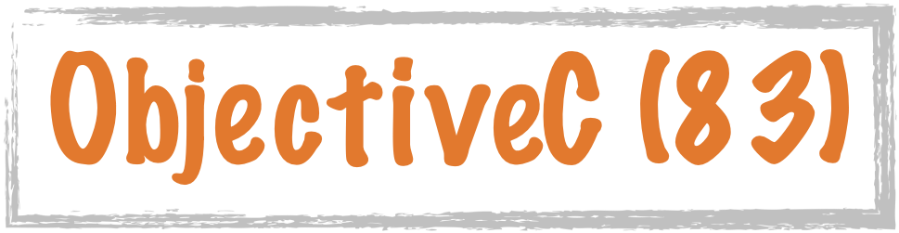








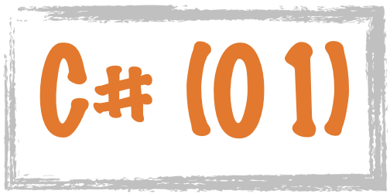


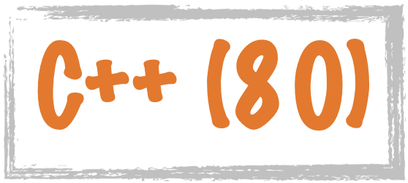









Science Calculations
System
System
C uses curly braces { } for code blocks.
Scripting/
Interpreted
http://en.wikipedia.org/wiki/History_of_programming_languages

Slide 7








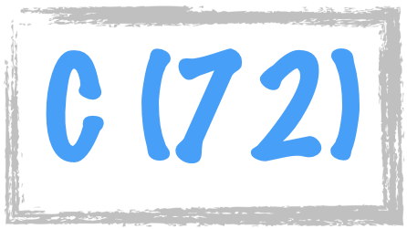




















Procedural
Hybrid
Object Oriented
Classes were added to PHP in 2000
https://en.wikipedia.org/wiki/Object-oriented_programming

Slide 8
OO Implementations Over Time
Python (1991)
C++ (1980)
Java (1995)
JavaScript (1995)
PHP (2000)
C# (2001)
P.S. The more languages you know the better – Dr. Chuck

Slide 9
import math
class Point:
def __init__(self, x, y):
self.x = x
self.y = y
def dump(self):
print('Object point@%x x=%f y=%f' %
(id(self),self.x,self.y))
def origin(self):
return math.sqrt(self.x*self.x+self.y*self.y)
pt = Point(4.0, 5.0)
Point.dump(pt)
print('Origin',pt.origin())
del(pt)
Object point@102ad1f10 x=4.000000 y=5.000000
Origin 6.4031242374328485
Python uses the concept of "self" to refer to the variables stored in the current instance. The constructor is by convention "__init__".
1991
cc_03_01.py

Slide 10
#include <iostream>
#include <math.h>
class Point {
public:
double x, y;
Point(double xc, double yc) {
x = xc;
y = yc;
};
void dump() {
printf("Object point x=%f y=%f\n", x, y);
}
double origin() {
return sqrt(x*x+y*y);
}
};
int main() {
Point pt(4.0, 5.0);
pt.dump();
printf("Origin: %f\n", pt.origin());
}
Object point x=4.000000 y=5.000000
Origin: 6.40312
C++ was initially implemented as a pre-processing pass that did textual transformations and then passed the code into the C compiler. There is no concept of "self" or "this".
1980
cc_03_01.cpp

Slide 11
import java.lang.Math;
public class Point {
double x,y;
Point(double x, double y) {
this.x = x;
this.y = y;
}
void dump() {
System.out.printf("%s x=%f y=%f\n",
this, this.x, this.y);
}
double origin() {
return Math.sqrt(this.x*this.x+this.y*this.y);
}
}
------------------------------------------------------
public class cc_03_01 {
public static void main(String[] args)
{
Point pt = new Point(4.0, 5.0);
pt.dump();
System.out.printf("Origin %f\n",pt.origin());
}
}
Point@7cef4e59 x=4.000000 y=5.000000
Origin 6.403124
The keyword "this" is a reserved word in the Java language. It is used to refer to the current instance of the class. The constructor is an un-typed function with the same name as the class. When you print "this" out, it resolves to the name of the class and an indication of which instance we are currently in. The toString() method produces the string.
Point.java
cc_03_01.java
1995

Slide 12
function Point(x, y) {
this.x = x;
this.y = y;
this.party = function () {
this.x = this.x + 1;
console.log("So far "+this.x);
}
this.dump = function () {
console.log("Object point x=%f y=%f",
this.x, this.y);
}
this.origin = function () {
return Math.sqrt(this.x*this.x+this.y*this.y);
}
}
pt = new Point(4.0, 5.0);
pt.dump();
console.log("Origin %f",pt.origin());
Object point x=4 y=5
Origin 6.4031242374328485
JavaScript takes the "this" and "new" keywords from Java but not much else. There is no "class" keyword. Formatted The way methods are defined take inspiration from functional languages like Scheme and use the "first-class function" pattern. Output tracks C very closely. The class definition itself overloads the "function" keyword.
TypeScript is an "evolved" version of JavaScript and adds "class" and "this" keywords allowing for a more traditional Java-like syntax for declaring objects.
1995
cc_03_01.js

Slide 13
class Point {
private $x, $y;
public function __construct($x, $y) {
$this->x = $x;
$this->y = $y;
}
public function dump() {
printf("Object point x=%f y=%f\n",
$this->x, $this->y);
}
public function origin() {
return sqrt($this->x*$this->x+
$this->y*$this->y);
}
}
$pt = new Point(4.0, 5.0);
$pt->dump();
printf("Origin %f\n",$pt->origin());
Object point x=4.000000 y=5.000000
Origin 6.403124
PHP introduced Object Orientation in PHP 4 in 2000 so it could borrow patterns like "this", "class", and "new" from languages like Java. Because PHP started with Perl 😞 , variables start with '$'. Also, PHP uses the '.' operator for concatenation for the "object lookup" operator, PHP had to use "->" which is inspired by the syntax C uses with a pointer to a structure.
2000
cc_03_01.php

Slide 14
using System;
public class Point
{
public double x,y;
public Point(double cx, double cy) {
x = cx;
y = cy;
}
public void dump() {
Console.WriteLine("Point object x={0} y={1}", x, y);
}
public double origin() {
return Math.Sqrt(x*x+y*y);
}
}
class TestPoint{
public static void Main(string[] args)
{
Point pt = new Point(4.0, 5.0);
pt.dump();
Console.WriteLine("Origin {0}", pt.origin());
}
}
Point object x=4 y=5
Origin 6.40312423743285
Microsoft's C# was relatively recent and so it could look at the other approaches and pick what they saw as the best parts. C# took most of its inspiration from Java.
2001
cc_03_01.cs

Slide 15
Using C to Build OO Support
How was Python's OO layered on top of C?

Slide 16
import math
class Point:
def __init__(self, x, y):
self.x = x
self.y = y
def dump(self):
print('Object point@%x x=%f y=%f' %
(id(self),self.x,self.y))
def origin(self):
return math.sqrt(self.x*self.x+self.y*self.y)
pt = Point(4.0, 5.0)
Point.dump(pt)
print('Origin',pt.origin())
del(pt)
Object point@102ad1f10 x=4.000000 y=5.000000
Origin 6.4031242374328485
1991
cc_03_01.py

Slide 17
#include <stdio.h>
#include <stdlib.h>
#include <math.h>
struct Point {
double x;
double y;
void (*del)(const struct Point* self);
void (*dump)(const struct Point* self);
double (*origin)(const struct Point* self);
};
void point_dump(const struct Point* self)
{
printf("Object point@%p x=%f y=%f\n",
self, self->x, self->y);
}
void point_del(const struct Point* self) {
free((void *)self);
}
double point_origin(const struct Point* self) {
return sqrt(self->x*self->x + self->y*self->y);
}
struct Point * point_new(double x, double y) {
struct Point *p = malloc(sizeof(*p));
p->x = x;
p->y = y;
p->dump = &point_dump;
p->origin = &point_origin;
p->del = &point_del;
return p;
}
int main(void)
{
struct Point * pt = point_new(4.0,5.0);
pt->dump(pt);
printf("Origin %f\n", pt->origin(pt));
pt->del(pt);
}
Object point@0x600003e94030 x=4.000000 y=5.000000
Origin 6.403124
1975
cc_03_01.c

Slide 18
Building a Python str() Class

Slide 19
Building a Python list() Class

Slide 20
Building a Python dict() Class

Slide 21
Summary

Slide 22
Acknowledgements / Contributions
These slides are Copyright 2023- Charles R. Severance (online.dr-chuck.com) as part of www.cc4e.com and made available under a Creative Commons Attribution 4.0 License. Please maintain this last slide in all copies of the document to comply with the attribution requirements of the license. If you make a change, feel free to add your name and organization to the list of contributors on this page as you republish the materials.
Initial Development: Charles Severance, University of Michigan School of Information
Insert new Contributors and Translators here including names and dates
Continue new Contributors and Translators here

